Slide 1
Collaborative Platform 5
Team Members
Product Owners
Jorge Travieso
Adrian Alfonso
Juan Caraballo
Robert Loredo
Spring 2015

Slide 2
Problem Solution
Need for
Better interaction among users of the system.
Fast way to set up meetings.
The Collaborative Tools
Video Conference
Screen Sharing
Virtual Whiteboard
Chat Room
Simple Scheduling

Slide 3




Sprint # 4 Planning
8 Points
8 Points
8 Points
8 Points

Slide 4
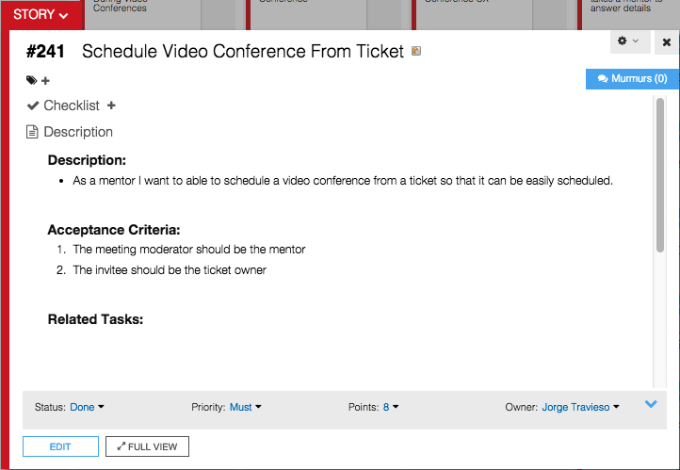

Slide 5
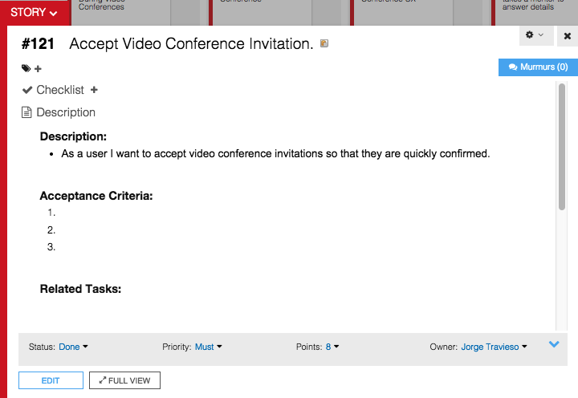

Slide 6
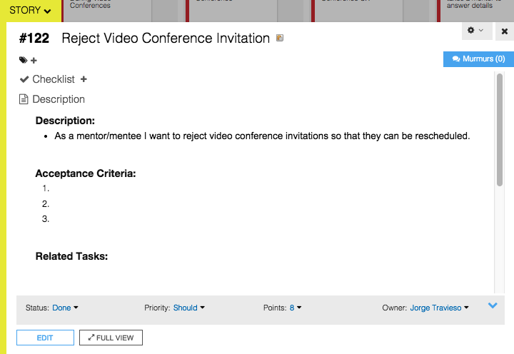

Slide 7
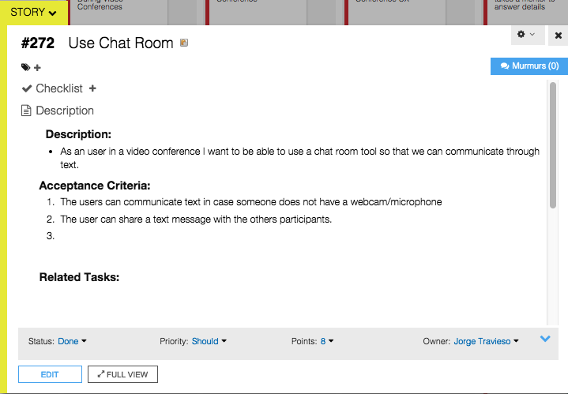

Slide 8
Sprint #4 Planning
4 User Stories
Personal Mark: 32 Points / 32 Planned
Sprint Velocity: 72 Points
Estimate based on
Documentation update time
Design and implementation

Slide 9
Self Review
User Story | Status | Accepted
Schedule Meeting From Ticket | Done | Accepted
Accept Invitation | Done | Accepted
Reject Invitation | Done | Accepted
Use Chat Room | Done | Accepted

Slide 10
Daily Scrums Summary
Major Accomplishments
Updated the documentation
Use case model, sequence diagrams
Added features
Chat room for video conferences.
Schedule meetings from tickets.
Accept and reject video conference invitations.

Slide 11
Documentations Updates

Slide 12
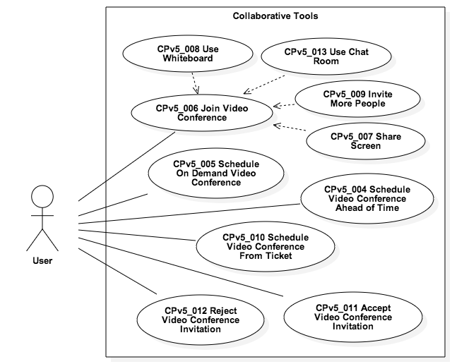
Use Case Model

Slide 13
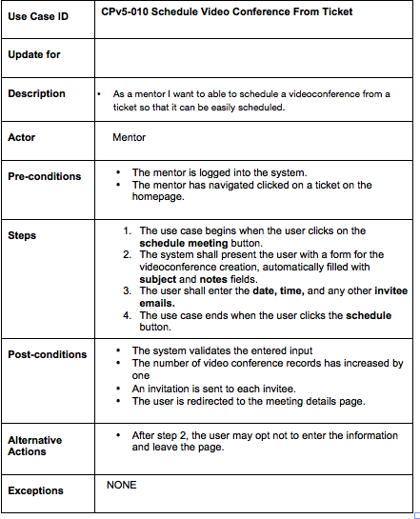

Slide 14
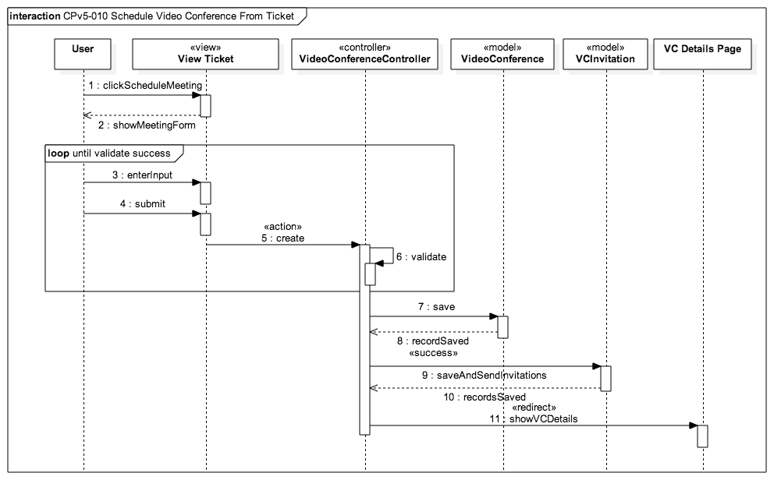

Slide 15
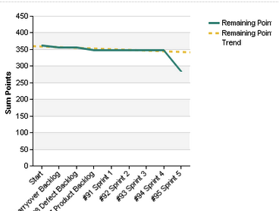
Burndown Chart

Slide 16
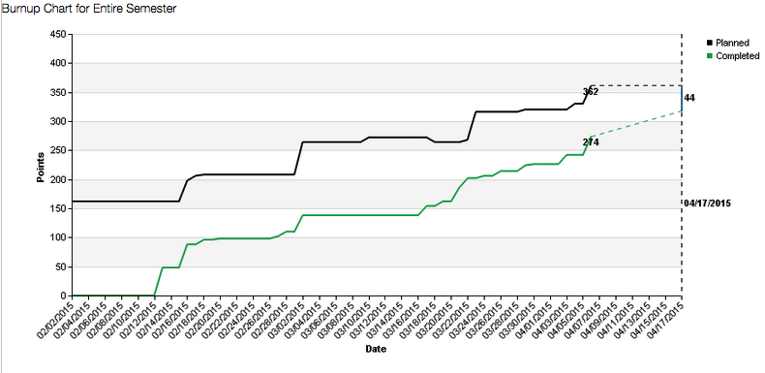
Burnup Chart

Slide 17
Demo
http://cp-dev.cis.fiu.edu/coplat/index.php/videoConference

Slide 18
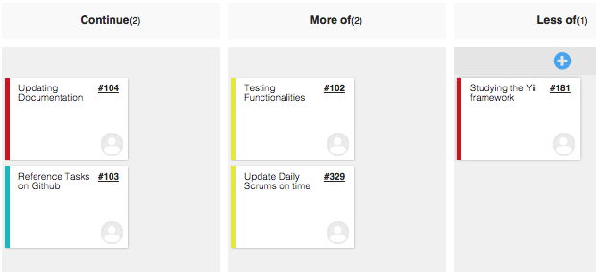
Sprint #4 Retrospective

Slide 19
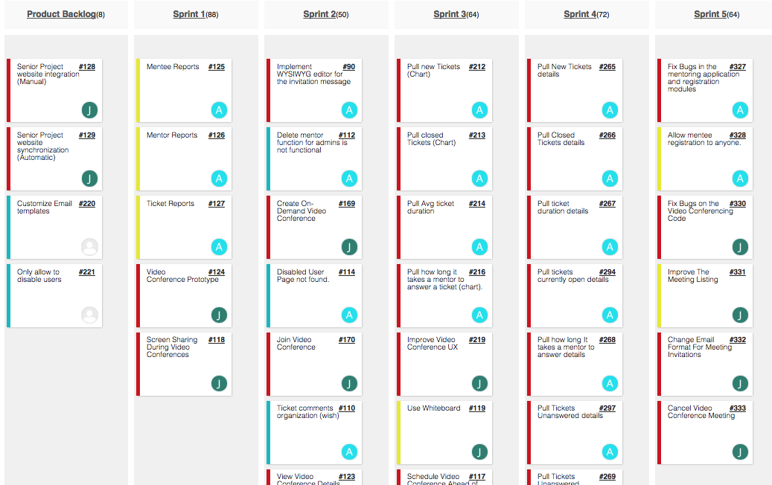
Sprint 5 Planning

Slide 20
Sprint # 5 Planning
User Story | Status | Points
Defect - Join Video Conference | To-Do | 16
Improve The Meeting Listing | To-Do | 4
Change Meeting Invitation Email Format | To-Do | 4
Cancel Video Conference Meeting | To-Do | 8

